Slide 1
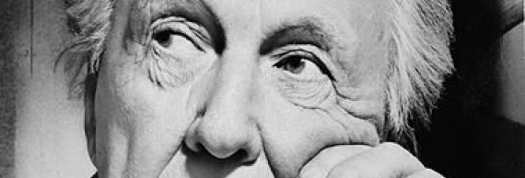
Frank Lloyd wright’s pope-leighey house
A Story of Innovation’s Triumph Despite Severe Economic Downturn
Images Source: Library of Congress, Prints and Photograph Division,

Slide 2
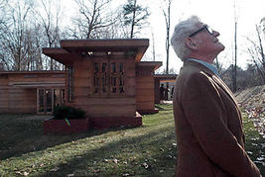
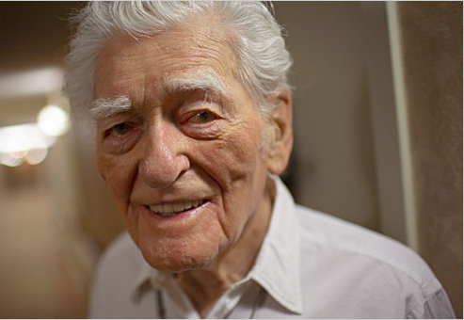
"There are certain things a man wants during life, and, of life. Material things and things of the spirit. The writer has one fervent wish that includes both. It is for a house created by you."
Great Depression: 1929 – 1939
Loren Pope worked an only $50 per week job as a copy editor at the Washington Evening Star
Frank Lloyd Wright built the first Usonian Home for Herbert and Katherine Jacobs in 1937 for just $5,000
Pope struggled to allocate sufficient funds– borrowing money during the Great Depression was difficult
The Loren Pope Residence was completed in 1941 for $7000 due to increased cost of building materials

Slide 3
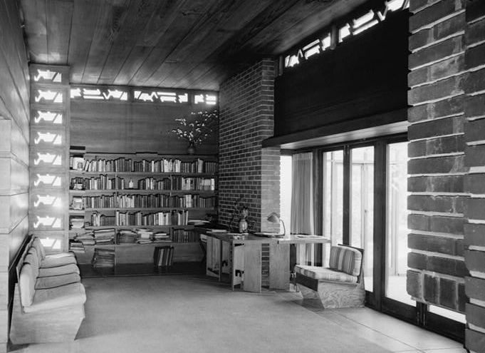
“Dear loren pope: of course I am ready to give you a house”
Carport
L-shaped single story
Board and batten panel walls
Structural glass
Large living room
Built-in furniture
Radiant heating system
Low-pitched rooflines
Open interior plan
Clerestory windows
Cherokee red concrete floor
Piano hinges
Central fireplace
Deep overhangs
1,200 sq ft
Solar Hemicycle design

